Slide 1
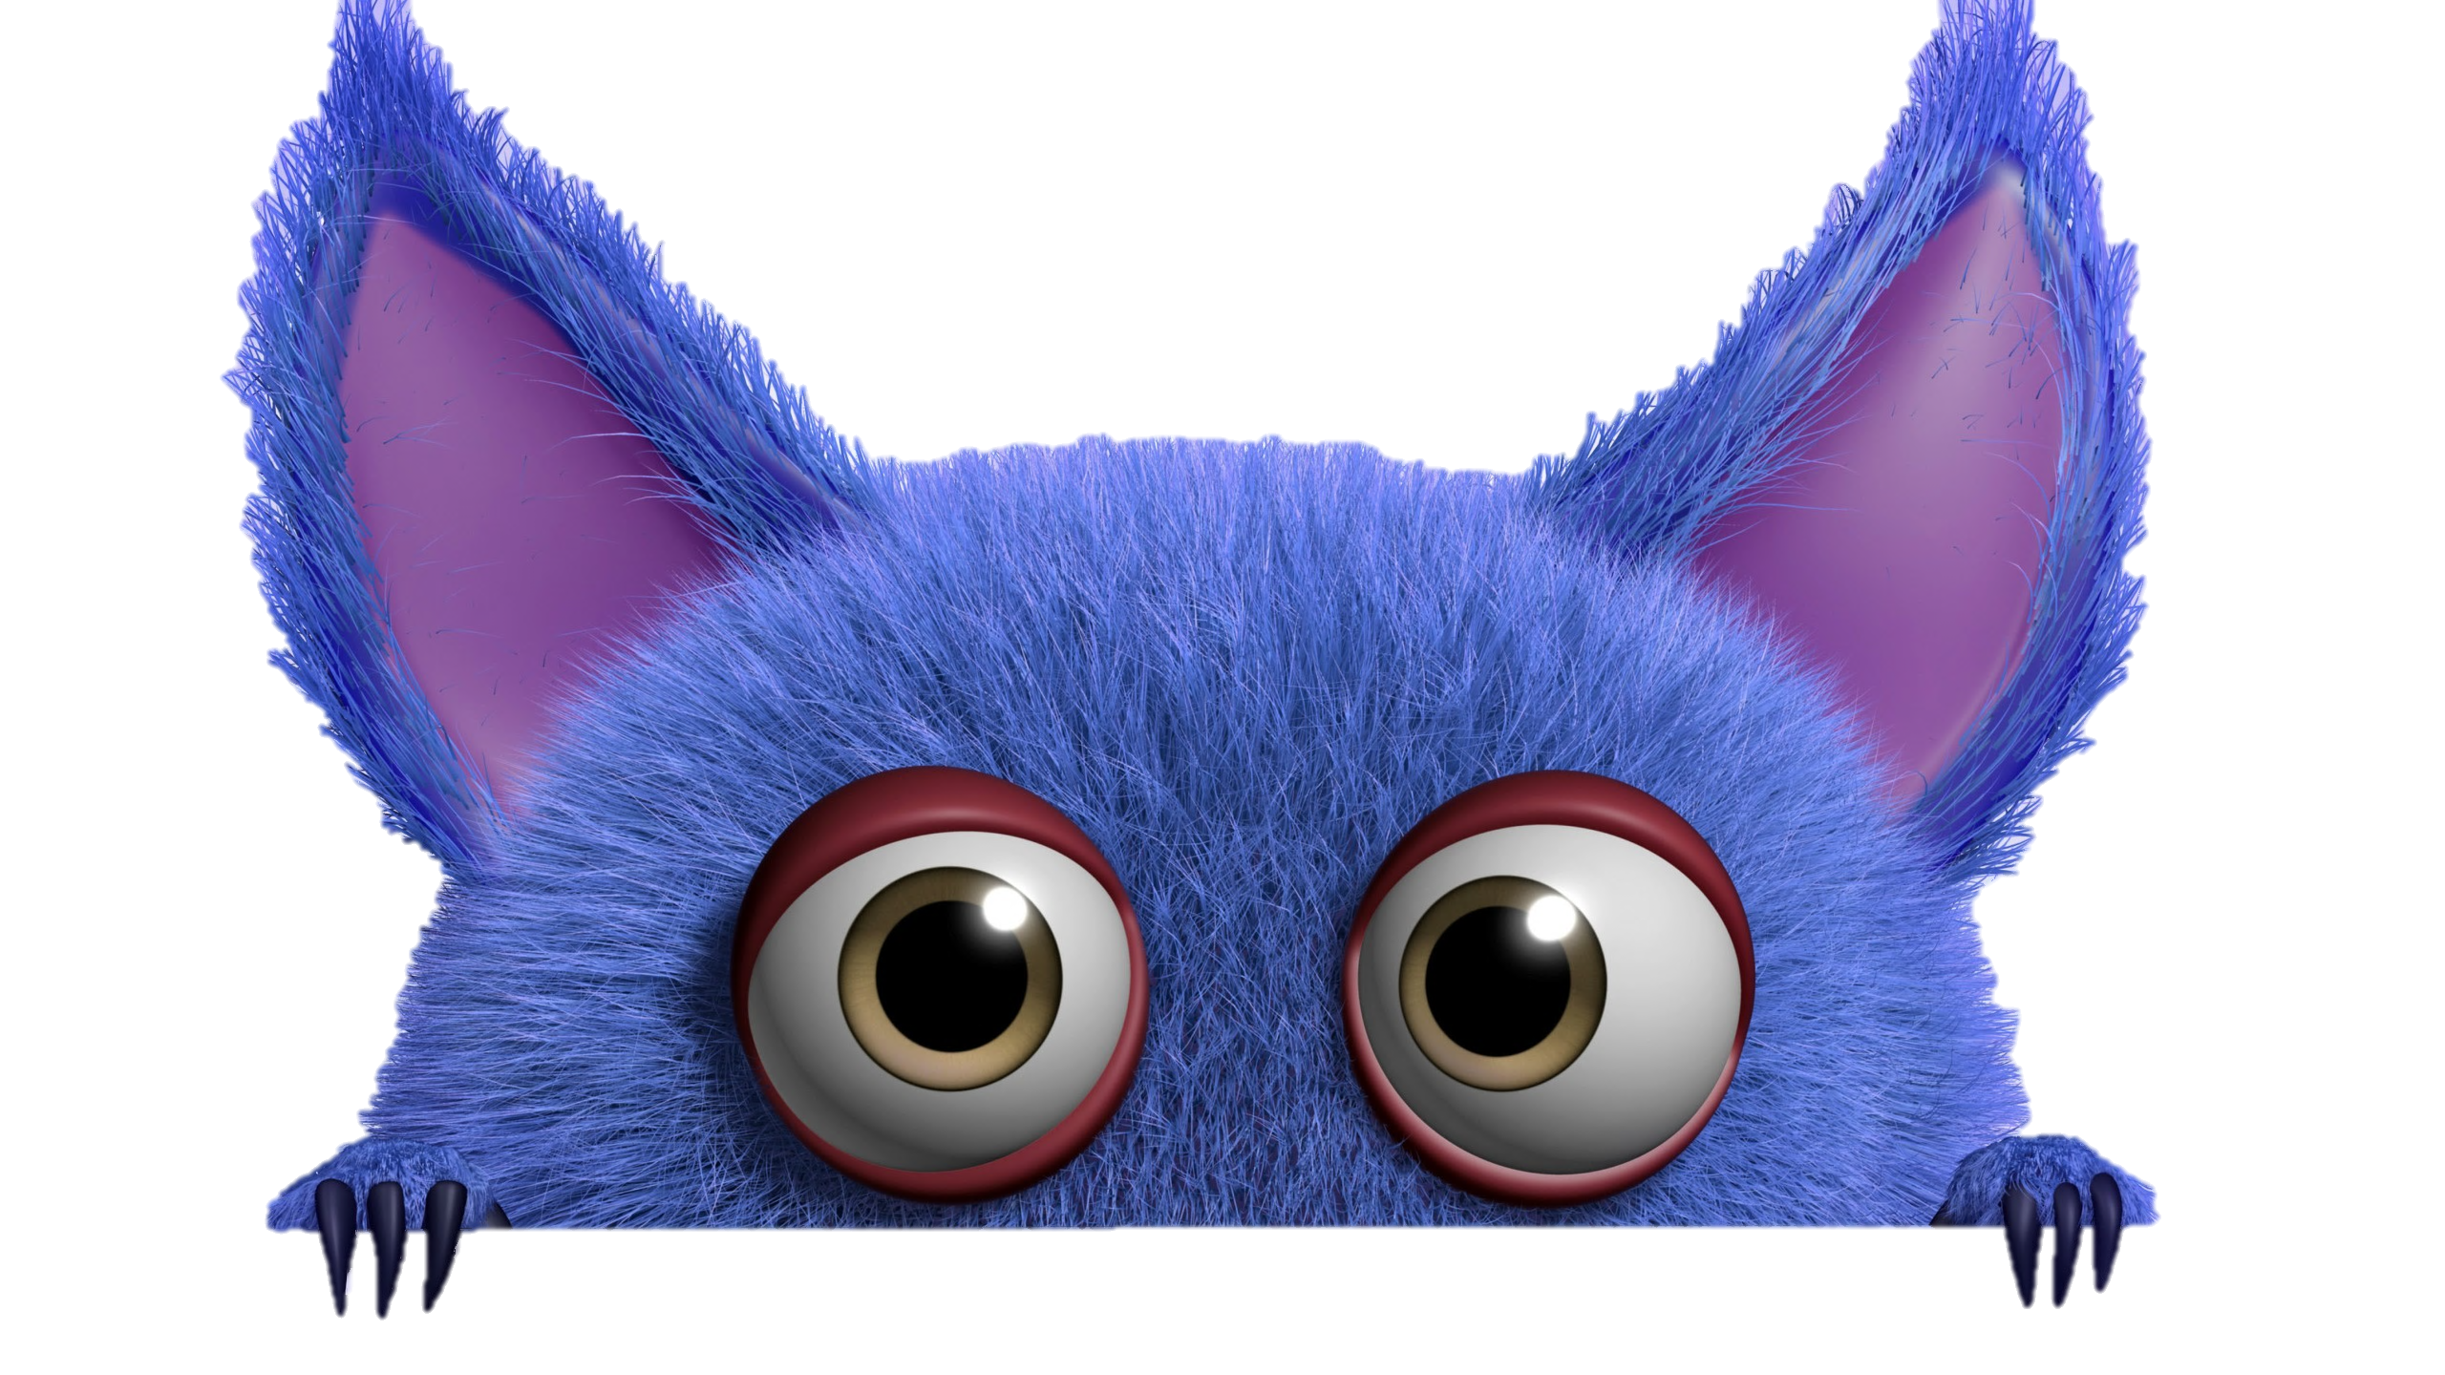
TRÒ CHƠI HỘP QUÀ BÍ MẬT
Gift box secret game

Slide 3
Question 1 ?
Answer
You are given 3 candies
GO HOME

Slide 4
Question 2 ?
Answer
You are given 5 candies
GO HOME

Slide 5
Question 3 ?
Answer
You are given 7 candies
GO HOME

Slide 6
Question 4 ?
Answer
You are given 2 candies
GO HOME

Slide 7
Question 5 ?
Answer
You are given 8 candies
GO HOME

Slide 8
Question 6 ?
Answer
You are given 6 candies
GO HOME

Slide 9
Question 7 ?
Answer
You are given 9 candies
GO HOME

Slide 10
Question 8 ?
Answer
You are given 5 candies
GO HOME

Slide 11
Question 9 ?
Answer
You are given 2 candies
GO HOME

Slide 12
Question 10 ?
Answer
You are given 4 candies
GO HOME

